Slide 1
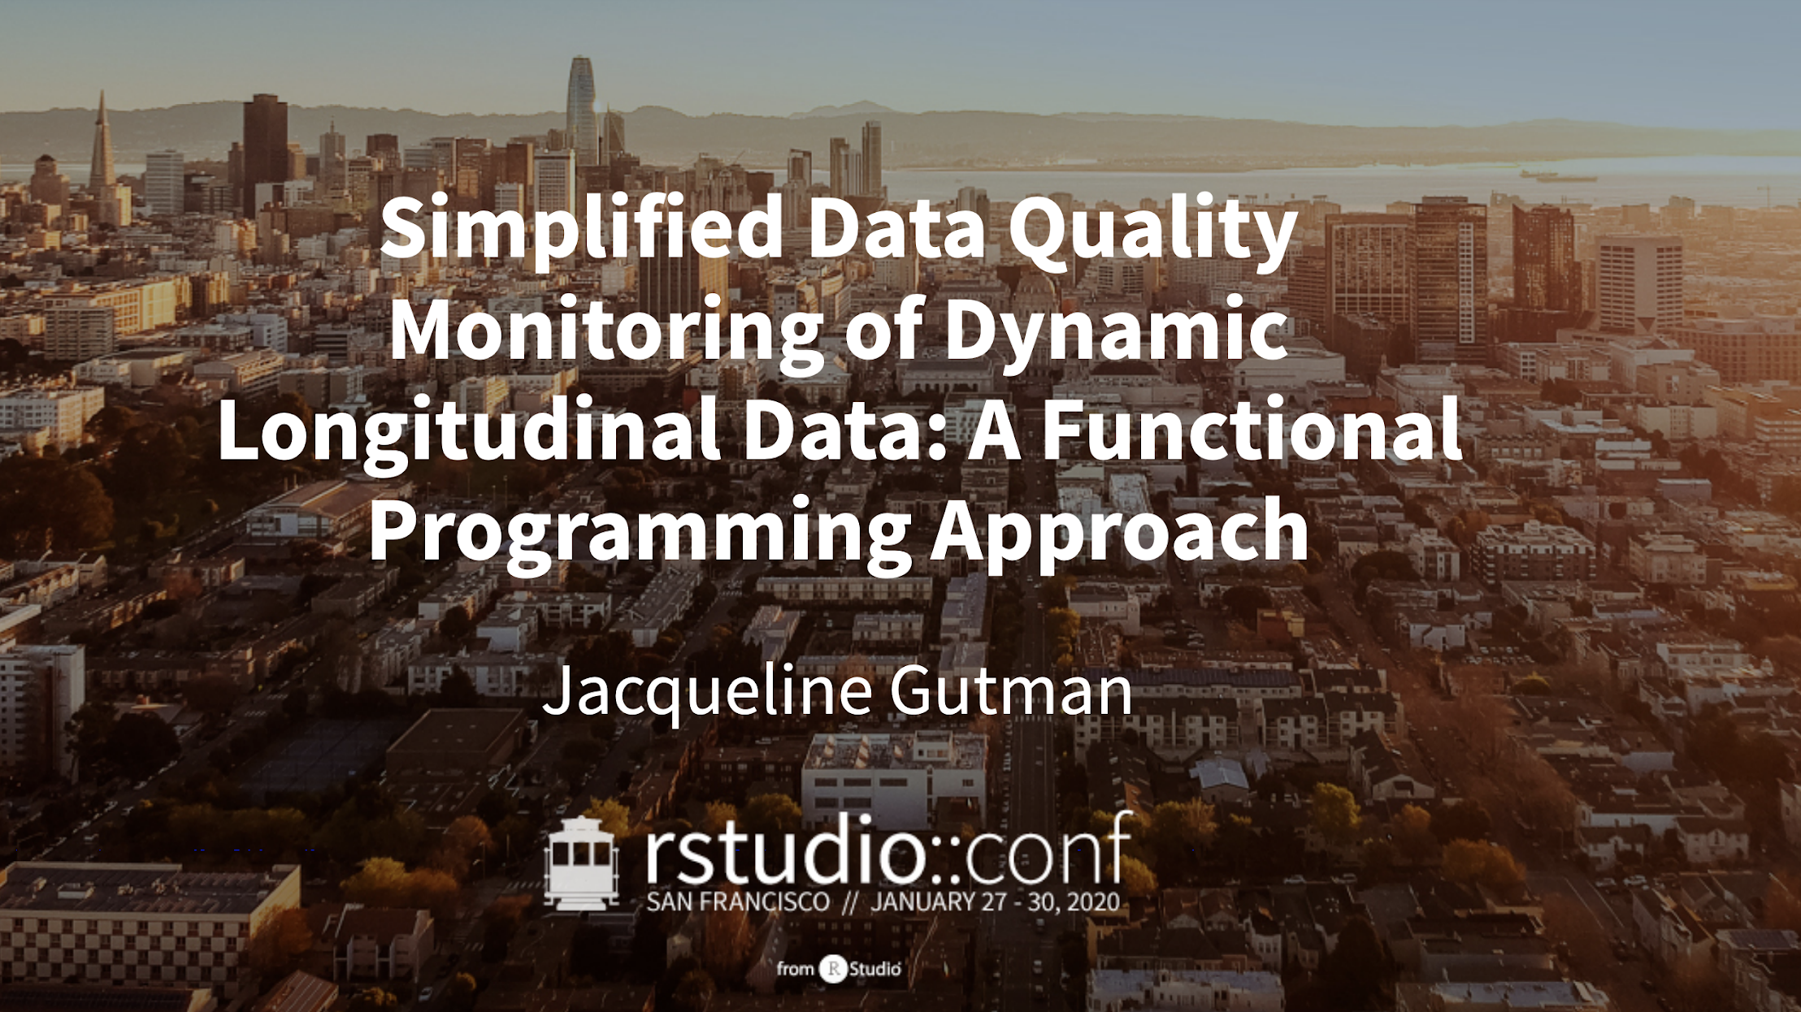
@dynamicdataduo
Notes:
Okay. I’m going to talk about how we take a functional approach to data science programming to monitor data quality in longitudinal patient data.
Benchmark: 0:10

Slide 2


We process dynamic EHR data
Diagnosis
Visits
Demographics
Structured Data Processing
Labs
Therapies
EHR
Pathology
Discharge Notes
Unstructured Data Processing
Physician Notes
RWE Database
Radiology Report
Hospital
Reports
Notes:
At Flatiron Health, we work with electronic health records data, and we have records from over 2 million cancer patients in the United States.
That data gets continuously updated as we incorporate new variables, new record types, and new patient populations. Every month, we deliver snapshots of that data to partners and clients with a 30 day recency. This means that the time from a patient experience or outcome being observed in the clinician’s record to the time that observation is in the hands of researchers who can generate insights from it is only 1 month, and that data needs to be high enough quality that it can support regulatory decision making.
Benchmark: 0:55

Slide 3
National, longitudinal real-world datasets refreshed monthly, with 30-day recency
Advanced Head & Neck Cancer
Advanced Gastric Cancer
Advanced Melanoma
Advanced Non-Small Cell Lung Cancer
Advanced Urothelial Carcinoma
Chronic Lymphocytic Leukemia
Acute Myeloid Leukemia
Diffuse Large B-Cell Lymphoma
Early Breast Cancer
Hepatocellular Carcinoma
Mesothelioma
Metastatic Breast Cancer
Metastatic Colorectal Cancer
Metastatic Pancreatic Cancer
Metastatic Prostate Cancer
Metastatic Renal Cell Carcinoma
Multiple Myeloma
Ovarian Cancer
Small Cell Lung Cancer
Follicular Lymphoma
Endometrial Cancer
Notes:
We currently deliver national longitudinal datasets on 21 distinct cancer types each month, and these datasets have some shared but non-identical data structures.
So we needed a framework for detecting and monitoring unusual changes within and across variables, cancer types, patient populations. And we need to be able to do this over time, with confidence in the quality and consistency of the data for each new dataset we build as compared to others we’ve built out previously and continue to maintain and grow each month.
Benchmark: 1:35

Slide 4
How we approach our problem
OBJECTIVES
Codify statistical and domain knowledge in a library of composable, modular functions
Decouple the high-level checks and reasoning from the low-level implementation details
Extend reasoning about a single dataset to apply across an expanding number of datasets
BENEFITS
Reproducible and documented best practices are easily shared
Abstraction reduces the cognitive complexity of an analysis and makes reasoning more transparent
Easier to scale analysis not just within a dataset, but as the number of datasets and elements increase
Notes:
In order to meet this challenge, we needed to take the statistical and domain knowledge of our staff and codify that into a library of modular functions which are testable, clear in intent, and able to be composed together into higher-level more abstract processes.
In order to foster collaboration between cross-functional peers, we wanted to decouple the high-level checks and reasoning from the low-level implementation details, to make those checks more transparent and interpretable.
And finally, we wanted a flexible approach that could take reasoning and code originally developed for working with a single dataset, and seamlessly extend it to situations of analyzing many datasets simultaneously, without breaking down every time the structure of a new dataset differed in minor but meaningful ways from previous datasets.
Benchmark: 2:40

Slide 5
Core principles of functional programming
Functions!
that can be composed into higher-order functions (compositionality)
which abstract out what is being done (declarative) from how it will be carried out (imperative)
and which avoid side-effects and external state dependencies (immutability)
Notes:
So our approach this problem is grounded in functional programming, which often get bogged down in computer science jargon but really comes down to a few key things.
>> Most importantly--functions, lots of functions, and functions as first-class citizens that we can treat as any other variable and pass as inputs to other functions, and luckily for us this is really intrinsic to the internals of how R works
>> Next, it means that we can string these functions together into higher order functions that return other functions depending on the conditions and context of how we’re using them.
>> Next, these functions should have very clear declarative names, which gives us some additional degrees of separation from the mechanics of the implementation, and allows us to reason about what needs to be done while abstracting away how that process will be carried out.
>> And finally, it means that we want these functions to strive for some degree of purity, in that they avoid side effects and dependencies on variables and states outside of the world of the function. That gives us a sense of confidence that no matter what else is in our environment, no matter what order we run the function in or how many times we call it, if we provide the same input we can expect to get the same output out of it.
Benchmark: 4:30

Slide 6
Building blocks of our approach to data quality
Conceptual code review
NESTED DATA STRUCTURES
Tibbles to stash your tibbles!
PROBLEM / DOMAIN
EXPERTISE
PACKAGE DEVELOPMENT
Promote visibility, unit testing and
documentation for your functions
DIFFERENTIATED CODE REVIEW
For technical and non-technical
project team members
TECHNICAL EXPERTISE
Implementation code
review
Notes:
We have some idiosyncratic ways of working that really go hand in hand with our functional approach to data science.
>>> Firstly, we use nested data structures as a convenient way of storing and organizing the data, and making that jump from a single dataset, to many datasets.
>>> Secondly, we emphasize package development rather than standalone analyses. This supports not just code reusability, but it also creates a culture that promotes visibility of code between siloed teams, and strongly encourages the development of unit testing and function documentation.
>>> And finally, this approach really empowers a kind of differentiated code review that is more inclusive of non-technical team members.
>> When we talk about code review, we often think exclusively about software engineers, and sometimes data scientists, checking the implementation of a particular piece of code.
>> But on our cross-functional teams, we also want to ensure that those closest to the intention are reviewing whether the approach we are taking is reasonable, and not just whether it is implemented correctly. So this style of programming supports a team structure where those with significant problem and domain expertise can undertake a conceptual code review, and those with technical expertise can focus on reviewing the implementation in the code.
Benchmark: 6:10

Slide 7
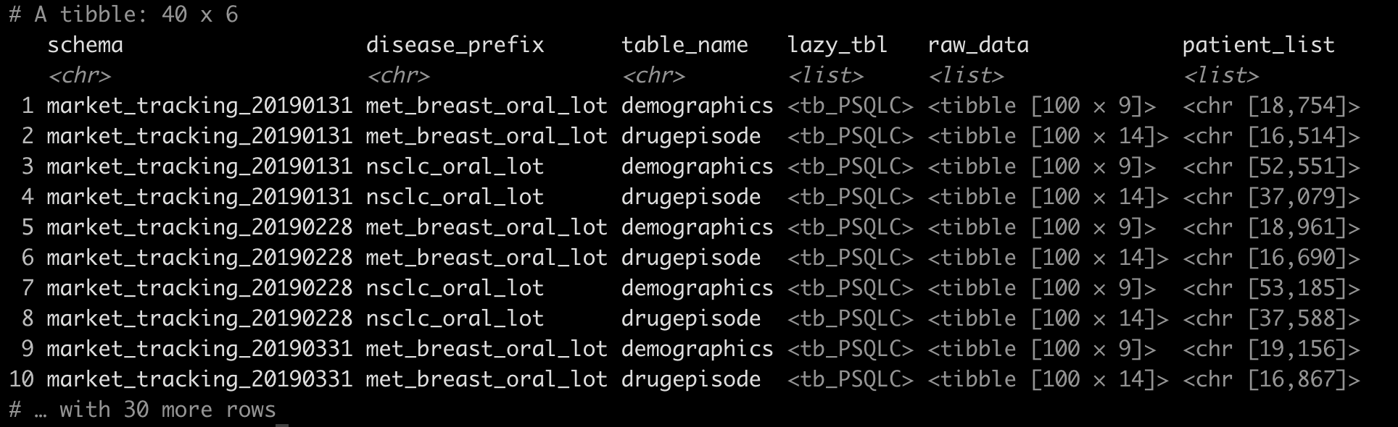
Store tibbles, lists, and in-database lazy tbls
as columns in a nested tibble
Data + metadata + evaluation metrics + summary statistics = FRIENDS FOREVER
Notes:
How do nested data structures come into play? Columns in a tibble are really just lists of objects, and those objects may themselves be scalars, or they may be vectors or lists in the case of list-columns. This means that we can store just about anything we want within a list-column of a tibble, using the tibble as a suitcase that allows raw data to travel together with its associated metadata, provenance, fitted models, and summary statistics all as a single row in our parent tibble.
>>> In this tibble, for example, the lazy_tbl column is just a list of lazy connections to different tables in a Postgres database, and we can iterate over those connections with mutate and map to create new list columns of raw data or of patients, storing everything together in one row.
Benchmark: 7:15

Slide 8
Nested data structures
for comparing and evaluating multiple datasets
count_records <- purrr::partial(execute_query,
select = "COUNT(*)")
count_patients <- purrr::partial(execute_query,
select = "COUNT(distinct patientid)")
fetch_patients = purrr::partial(execute_query,
select = "DISTINCT patientid",
limit = 100)
data %<>%
mutate(n_records = purrr::map(lazy_tbl, count_records, con = conn),
n_patients = purrr::map(lazy_tbl, count_patients, con = conn),
cohort = purrr::map(lazy_tbl, fetch_patients, con = conn))
Notes:
So how might we use this type of data structure? Well, we can take a very broad and generic function, for example, to execute a query against our database, and then use partial functions to fill in some of the arguments to that function to make it do something more specific, like execute a query to count all unique patients in a dataset, or execute a query to return a list of all patients meeting specific inclusion criteria. We can apply that function to all relevant nested datasets within our parent dataframe (using map and map_if).
Benchmark: 8:00

Slide 9
What does all this get you?
Readability
Compositionality
Reproducibility
Robustness
Efficiency
Notes:
So, what does all this get you? We found the benefits can really be broken down along these 5 dimensions.
Benchmark: 8:05

Slide 10
Readability
Abstraction and Declarative intent
Analysis code can be understood and sanity-checked by non-technical staff
Clarity of intent: abstract declarative code is self-documenting
Docstrings and unit tests to align implementation with intention
compare_snapshots(
january_data,
february_data,
fn = compute_time_to_dx)
find_added_patients(
old_data =
january_data$cohort,
new_data =
february_data$cohort)
Notes:
First and foremost, this approach really lends itself to readable code. Higher level abstractions that emphasize declarative intent over procedural instructions are more easily understood and sanity checked by non-technical staff, which supports the kind of differentiated code review I mentioned earlier.
This also lends itself to self-documenting code, where the function and variable names themselves describe what is being done, and we start with the declarative intent, and work our way backwards to the implementation. The actual function design then becomes a process of aligning the implementation with the intention.
Benchmark: 8:50

Slide 11
Compositionality
Reasoning with higher level functions
### Function definitions
process_drug_episodes <- . %>%
filter_persistent_patients %>%
compute_change_from_prev(
var = “num_drug_episodes”,
prev_var = “prev_drug_episodes”) %>%
summarize_change_distribution(
change_var = “change_num_drug_episodes”)
### Analysis code
data_processed <-
process_drug_episodes(data)
Notes:
Another advantage we get is compositionality, which again means we can string together simpler functions into higher level functions of increasing complexity without compromising flexibility, readability, or testability.
>>> We’re all familiar with the magrittr pipe, and how we might use the pipe to compose functions into a pipeline of operations. Well, we can save that as a functional sequence if we want to be able to consistently apply it over multiple datasets.
Benchmark: 9:35

Slide 12
Compositionality
Reasoning with higher level functions
lm(Sepal.Length ~ Species,
data = iris) %>%
broom::tidy(
conf.int = TRUE) %>%
filter(p.value < 0.05) %>%
arrange(desc(statistic))
tidy_lm <- purrr::compose(
lm,
~ broom::tidy(.x,
conf.int = TRUE),
~ filter(.x,
p.value < 0.05),
~ arrange(.x,
desc(statistic)),
.dir = “forward”)
tidy_lm(Sepal.Length ~ Species,
data = iris)
Example adapted from Colin Fay’s blog
Notes:
And we can take a similar approach using the compose function in the purrr package.
Let’s say we often find ourselves piping a model into a few other functions to tidy it up. We might want to extract the coefficients and confidence intervals, focus in on those effects meeting some significance threshold, and sort the effects in some way.
>>> Now, instead of having to repeat the pipe again and again with different models and different data, we can compose that into a new succinct and appropriately named function for a clean and interpretable workflow that’s also less error-prone to copy-paste errors.
Benchmark: 10:25

Slide 13
Compositionality
Reasoning with higher level functions
### Analysis code
cohort %<>%
left_join(demographics) %>%
left_join(mortality) %>%
left_join(drugepisode) %>%
left_join(progression)
### Function definitions
left_join_all <- function(...) {
purrr::reduce(list(...),
.f = dplyr::left_join)
}
### Analysis code
cohort %<>%
left_join_all(demographics,
mortality,
drugepisode,
progression)
Notes:
We might also want to build wrappers around built in functions, and decouple the definition of those wrappers from where we plan to use them in the code, which can add another layer of readability.
So for example instead of stacking all our left joins one after another, we might find it cleaner to use a wrapper function to do all the joins in what is one perceived step for the code reviewer.
Benchmark: 11:00

Slide 14
Reproducibility
Avoiding side effects and external states
Running the same function with the same input should always produce the same result
Safeguard reproducibility with
Immutable inputs + outputs
Idempotent processes
Deterministic algorithms
But sometimes we need side effects!
Printing
Plotting
Saving output to disk
Notes:
Let’s also talk about reproducibility. We want to have confidence that for any analysis, running the same function with the same input should always produce the same result.
We can do this by developing functions where we avoid mutability—which is when calling the function changes the actual state or variables defined outside of the function—as well as preventing other kinds of side effects.
By doing this we can avoid hard to test for bugs, in which the success or failure of a unit test depends on things outside of the world of the function and its input. So the function behavior should not depend on what else existed in the global environment when the function was called, the number of times the function was run, or other external dependencies. >>>
Well, that’s all well and good, but sometimes side effects are desirable! Like printing or plotting to a display, or saving output to disk. A so-called pure function would never do these things.
Benchmark: 12:05

Slide 15
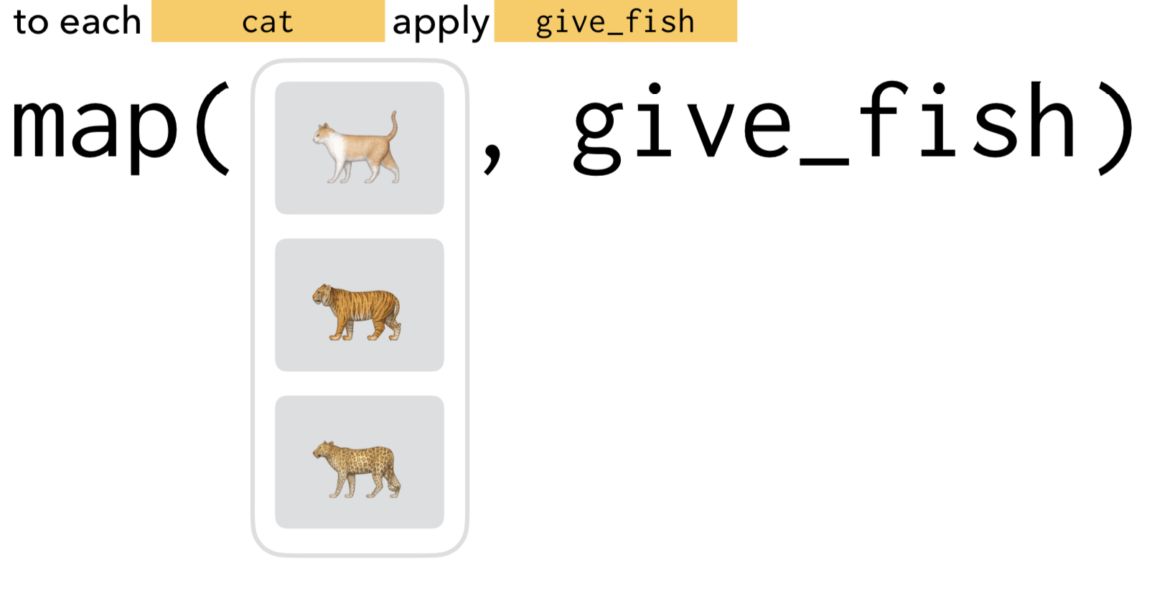
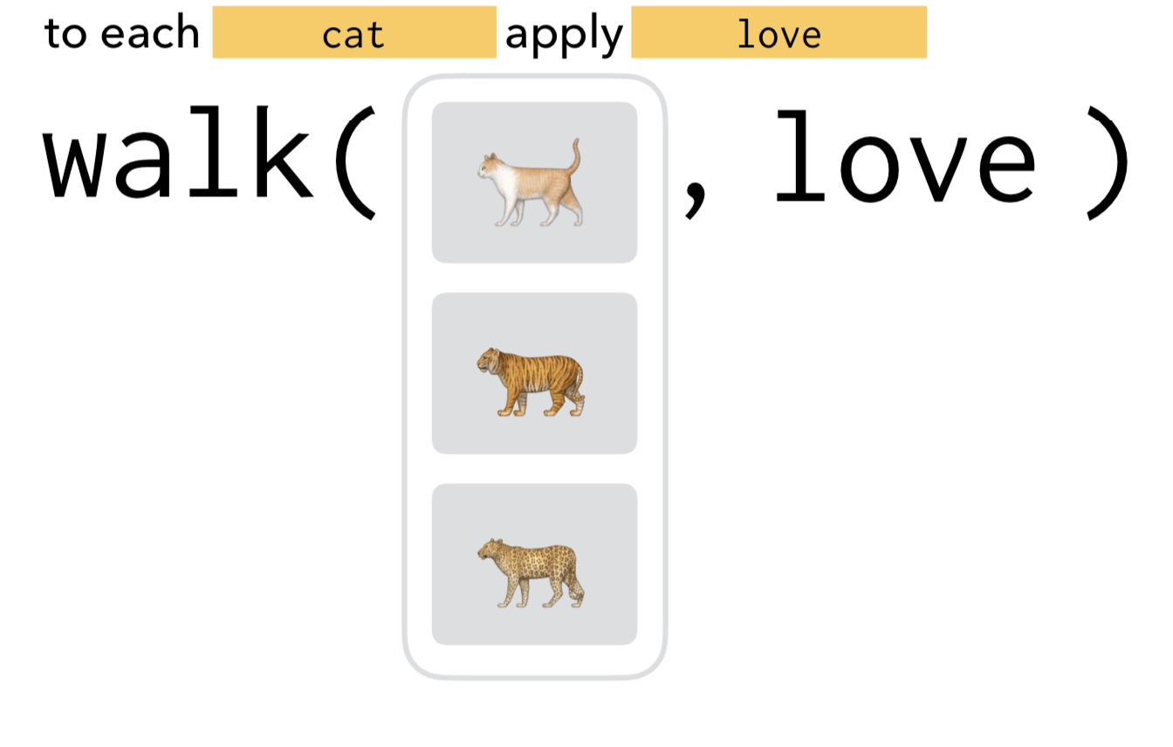
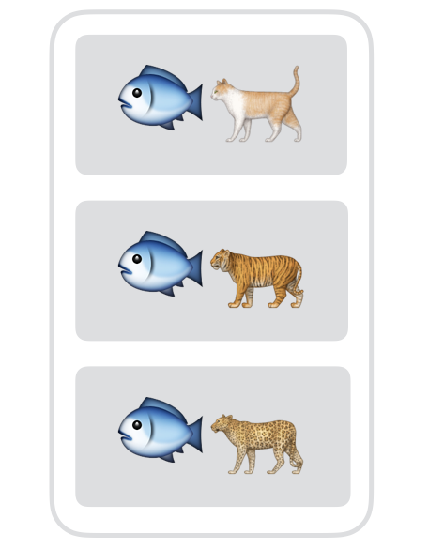
Reproducibility
Clearly separate pure functions from functions desired for their side effects
NO OUTPUT
O
U
T
P
U
T
Side effects desired!
No side effects intended!
Returns something
Graphic adapted from Charlotte Wickham
Notes:
In that case, it can be helpful to use a function naming convention that clearly distinguishes between functions that are pure and have no side effects, from those that are intended primarily for their side effects (for example, we might call the no side effects/return value functions get, count, and describe vs display, export, and render for those with intended side effects).
Best practice is to keep them separate in development and naming, document their intended uses clearly, and when iterating use purrr’s map vs walk intentionally to differentiate between the two types of functions.
Benchmark: 13:00

Slide 16
Robustness
Testability and elegant error handling
Functional modular code makes for happy unit testing
Avoid difficult to test code stemming from Mutability, Side-Effects, Responsibility overload, and Procedural instructions
Avoid side effects and maintain your functional flow
try-catch exception blocks can be refactored as higher order functions
error_prone_fn <- function(data) {
exprs
}
safe_fn <- purrr::safely(
.f = error_prone_fn,
otherwise = c())
data %>%
mutate(results = purrr::map(
input, safe_fn))
Notes:
Closely related to this is the idea of robustness. Modular, functional code that avoids mutability, side effects, and external dependencies is going to be easier to test. Code that is harder to test just won’t be tested, or will be less effectively tested, and more prone to unexpected errors. Using unit testing effectively means more robust code in the long run.
>> But what about expected errors? We talked about wanting code that doesn’t break down every time a new variable is added, or the data changes in other anticipated ways. The functional approach can help here too, by wrapping unsafe brittle functions with no exception handling in their own try-catch exception handlers.
The exception handled function can be returned as just another, more robust version of the function, and that new function can be mindlessly deployed in an analysis without breaking the functional flow of the code or requiring the analyst to think about every potential exception that might occur.
Here too, purrr comes to the rescue, with safely and other exception handlers that wrap any callable into a more robust version with its own bottom value, thus avoiding the side effects of exception throwing in the process.
Benchmark: 14:35

Slide 17
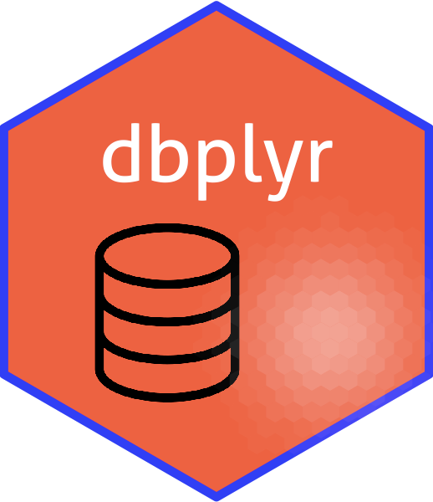


Efficiency
Delayed evaluation and lazy backends
parse_dateofdeath_chunked <- purrr::partial(dbplyr::do,
data_modified = dplyr::mutate(., dateofdeath = parse_dod(a)),
.chunk_size = 10000L)
parse_dateofdeath_chunked(mortality)
backend for databases
backend for data.tables
dtplyr
Notes:
Now, efficiency doesn’t have to come at the cost of readability, reliability, and robustness. The ability to take advantage of lazy evaluation and caching of previously computed values is built in here.
purrr is already built around a principle of delayed, just in time evaluation, so that’s already taken care of for us, and if we pair that with use of lazily evaluated backends for data manipulation, such as dbplyr or dtplyr, we can avoid doing more work than we need to do before it’s really needed.
For example, if we’re working with a table in a database, we can use the `do` function to perform some arbitrary computation on each chunk of the data, and avoid having to read in more data than we can process at once.
Benchmark: 15:40

Slide 18
Efficiency
Caching with memoise
Use when repeatedly evaluating a function over rows/chunks of data, with some repeated inputs
Performance gains depend on how often a function is being called with same arguments
compute_biomarker_status <- function(
biomarker_results){
exprs
}
compute_biomarker_status_cached <-
memoise::memoise(
compute_biomarker_status)
data %<>%
mutate(biomarker_status =
purrr::map(biomarker_results,
compute_biomarker_status_cached)
Notes:
Finally, if we expect that over the course of an analysis a function may be called several times with the same inputs, and that function execution is itself expensive, we can save some computation by caching or memoizing the results simply by wrapping the function with a call to memoise. We can store that cache locally or in S3, hit it up on subsequent function calls, only computing the result if it cannot be found in the cache or if the cache has been invalidated. And we can force the cache to invalidate or set it to invalidate automatically after a certain period of time if we want.
So since we’ve designed our functions in such a way that they should always return the same output when given the same input, we can avoid duplication of effort of recomputing the results for common inputs. We can decide how many recently returned results we want to store in memory and what should be that tradeoff for our use case between increased storage costs and increased computation.
Benchmark: 17:00

Slide 19


Thanks!
@jgutman
@dynamicdataduo
Notes:
Thanks! That’s it. Questions?
Benchmark: 20:00

